Slide 1



Computer Networks Performance Evaluation

Slide 2
Chapter 10
Markov Models
Performance by Design:
Computer Capacity Planning by Example
Daniel A. Menascé, Virgilio A.F. Almeida, Lawrence W. Dowdy
Prentice Hall, 2004

Slide 3

Outline
10.1. Introduction
10.2. Modeling Context
10.3. Motivating Examples
10.4. Model Construction
10.5. Model Solution
10.6. Model Interpretation
10.7. Model Assumptions and Limitations
10.8. Generalized Birth-Death Models
10.9. Beyond the Basics
10.10. Chapter Summary
10.11. Exercises
Bibliography

Slide 4
In part I
Performance terms have been introduced.
  response time
  throughput
  Availability
  reliability
  security
  Scalability
  extensibility
Performance results based on the operational laws have been defined and applied to sample systems.
  Utilization Law
  Service Demand Law
  Forced Flow Law
  Little's Law
  Interactive Response Time Law
Simple performance bounding techniques and basic queuing network models have been established as tools to evaluate and predict system performance.

Slide 5
The Goal of Part II
Motivate, establish, and explain the basic building blocks and underpinnings of the analytical techniques introduced in Part I.
To be able to understand what is inside "the black box“

Slide 6
System Modeling
Prototype model
  The physical construction of a scaled version of the actual system and executing a typical workload on the prototype
Simulation model
  writing of detailed software programs which (hopefully accurately) emulate the performance of the system
Analytical model
  capturing the key relationships between the architecture and the workload components in mathematical expressions

Slide 7
System Modeling
Prototype model
  high accuracy
  high costly
Simulation model
  less accurate
  much less costly than prototype models
Analytical model
  flexible, inexpensive, and easily changed
  lack of detail and more difficult to validate

Slide 8
Markov Model
In this chapter we focus in Markov model.
Markov model is an analytical model.

Slide 9
Why Markov Model?
Markov models are often used to explain the current interactions between various system components.
It can be altered to predict (hopefully, accurately) what would happen if various aspects of the system's hardware or of the system's workload change.
Thus, Markov models can be used for both
descriptive and predictive purposes.

Slide 10
To Create Markov Model
Constructing the state diagram by identifying all possible states that the modeled system may find itself.
Identifying the state connections (i.e., transitions)
Parameterzing the model by specifying the length of time spent in each state once it is entered (or, equivalently, the probability of transitioning from one state to another within the next time period).
Solving the model.
  Abstracting a set of linear "balance" equations from the state diagram
  Solving them for long term "steady state" probabilities of being in each system state.

Slide 11
Modeling Paradigm
model construction state transitions parameterization
Baseline model
model solution
?+?²+?³+..
model calibration
model alteration
Prediction model
model solution
?+?²/2+?³/2+..
model validation
Acceptable validate model

Slide 12
Model Construction
Model construction identifying
  the parameter type and
  parameter value of model

Slide 13
Model solution
After construction, the model must be solved.
prototype models
  running an experiment on the newly constructed hardware and monitoring its performance
simulation models
  running a software package (i.e., the simulator) and recording the emulated performance results
analytical models
  solving a set of mathematical equations and interpreting the performance expressions correctly

Slide 14
Model Calibration
After construction and solution, the model must be calibrated.
Calibration involves comparing the performance results obtained from the model against those observed in the actual system.
Often, one must return to a previous step since modeling errors may be discovered during calibration.
It is not atypical to cycle between the various steps before an acceptable model is found.
The modeled system is calibrated to match the actual system on a finite set of previously observed (i.e., baseline) performance measures

Slide 15
Accountability
Accountability is a validity check that the prediction is accurate.
Accountability is the final step.
Too often, this step is ignored. It is more normal to make a prediction, collect a consultant's fee, go on to another project (or vacation!), and never return to see if one's prediction actually came true.
The overall modeling paradigm is improved and the resulting prediction model is truly validated, only by:
  completing this final check.
  answering those harder series of questions when the predictions are incorrect.
  returning to a previous step in the modeling process.

Slide 16
Motivating Example #1: RWTE
Random Walk Through England
Consider a lad who is given a year to spend in England.
The only condition is that every day at 3:00 p.m., the lad must use his mobile phone to call his mother and simply let her know where he is and what he is doing
After only a couple of months, the mother deduces a definite pattern to her son's behavior.

Slide 17
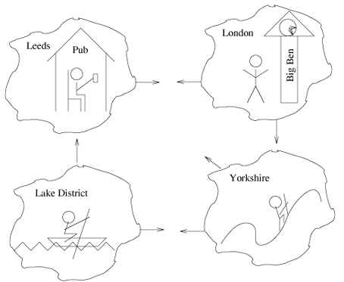
RWTE: Assumptions
The lad is always doing something in one of four locations
  drinking in a Leeds pub
  sightseeing in London
  kayaking in the Lake District
  hiking in the Yorkshire moors

Slide 18
RWTE: Parameters1
If the lad is in a Leeds pub, he is either likely to go sightseeing in London the following day (60%), or he will still be found in a Leeds pub (40%)
If the lad is in London, he is likely to be found in a Leeds pub the following day (20%) or will decide to go hiking in the Yorkshire moors (80%)
40%
60%
20%
80%

Slide 19
RWTE: Parameters2
Once found in the Lake District, there is very good chance that the lad will still be found kayaking the following day (70%), but there is a possibility that he will next be found hiking the moors (20%) or back in a Leeds pub (10% )
When found hiking in the moors, there is a good chance that he will still be hiking the following day (50%). However, he sometimes goes to a Leeds pub (30%) and sometimes decides to go kayaking in the Lake District (20%) the following day
40%
60%
20%
30%
80%
10%
70%
20%
50%
20%

Slide 20
RWTE: Questions
Question1: What percentage of days is the son actually not drinking in Leeds?
Question2: Once the son finishes a day of kayaking in the Lake District, how long will it typically be before he returns?
Question3: How many days each month can the bobbies expect to see the son driving to London after drinking in Leeds?
Question4: How many visits each month does the son typically visit their shop and typically how long does the son keep their kayak out each visit?

Slide 21
RWTE:
Model Construction-States
1. Enumerate all the possible states:
  state 1: Drinking in a Leeds pub
  state 2: Sightseeing in London
  state 3: Kayaking in the Lake District
  state 4: Hiking in the Yorkshire moors
Drinking in a
Leeds pub
(state1)
Sightseeing
in London
(state2)
Kayaking in
The Lake District
(state3)
Hiking in the
Yorkshire moors
(state4)

Slide 22
RWTE:
Model Construction-Transitions
2. State transitions:
  If in state 1, the lad may find himself next in state 1 or state 2
  If in state 2, the lad may find himself next in state 1 or state 4
  If in state 3, the lad may find himself next in states 1, 3, or 4
  If in state 4, the lad may find himself next in state 1, 3, or 4

Slide 23
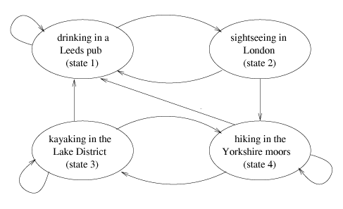
State Transitions

Slide 24
RWTE:
Model Construction-Parameters
Model parameterization
  State 1 goes directly back to state 1 with probability 0.4 and to state 2 with probability 0.6.
  State 2 goes directly to states 1 or 4 with probabilities 0.2 and 0.8, respectively.
  State 3 goes directly to states 1, 3, or 4 with probabilities 0.1, 0.7, and 0.2, respectively.
  State 4 goes directly to states 1, 3, or 4 with probabilities 0.3, 0.2, and 0.5, respectively

Slide 25
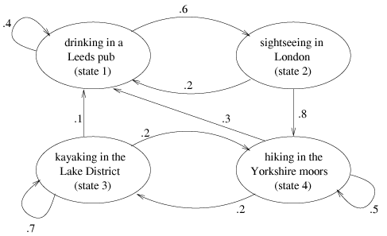
Parameters

Slide 26
Motivating Example #2:
Database Server Support
Consider a computer system with one CPU and two disks used to support a database server.
Users remotely access the server and typically login, perform some database transactions, and logout.
Each time 2 request (users) are in the system.
Fast Disk
CPU
Slow Disk

Slide 27
Database Server: Assumptions1
Each transaction alternates between using the CPU and using a disk.
The two disks are of different speeds, with the faster disk being twice as fast as the slower disk.
A typical transaction requires a total of 10 sec of CPU time.

Slide 28
Database Server: Assumptions2
Transactions are equally likely to find the files they require on either disk.
If a transaction's files are found on the fast disk, it takes an average of 15 seconds to access all the requested files.
If a transaction's files are found on the slow disk, it takes an average of 30 seconds to access all the requested files.

Slide 29
Database Server:
Questions
User's question: What response time can the typical user expect?
System administrator's question: What is the utilization of each of the system resources?
Company president's question: If I can capture Company X's clientele, which will likely double the number of users on my system, I will need to also double the number of active users on my system. What new performance levels should I spin in my speech to the newly acquired customers?
Company pessimist's question: Since I know that the fast disk is about to fail and all the files will need to be moved to the slow disk, what will the new response time be?

Slide 30
Database Server:
Model Construction-States
1. Enumerate all the possible states:
  State (2,0,0): both users are currently requesting CPU service.
  State (1,1,0): one user is requesting CPU service and the other is requesting service from the fast disk.
  State (1,0,1): one user is requesting CPU service and the other is requesting service from the slow disk.
  State (0,2,0): both users are requesting from the fast disk.
  State (0,1,1): one user is requesting service from the fast disk while the other user is requesting service from the slow disk.
  State (0,0,2): both users are requesting from the slow disk.

Slide 31
Database Server
Model Construction-Trans,
2. State transitions:
  If both users are at the CPU ( state (2,0,0)), one of the users could complete service at the CPU and go to either the fast disk (state (1,1,0)) or to the slow disk ( state (1,0,1))
  If one of the users is at the CPU and the other is at the fast disk (state (1,1,0)), either the user at the fast disk could finish and return to the CPU (state (2,0,0)), or the user at the CPU could finish and go to either the fast disk (state (0,2,0)) or to the slow disk (state (0,1,1)
  if one of the users is at the CPU and the other is at the slow disk (state (1,0,1)), either the user at the slow disk could finish and return to the CPU (state (2,0,0)), or the user at the CPU could finish and go to either the fast disk (state (0,1,1)) or to the slow disk (state (0,0,2).

Slide 32
Database Server:
Model Construction-Trans.
  If both users are at the fast disk (state (0,2,0)), one of the users could finish and return to the CPU (state (1,1,0)).
  If one of the users is at the fast disk and the other is at the slow disk (state (0,1,1)), either the user at the fast disk could finish and return to the CPU (state (1,0,1)), or the user at the slow disk could finish and return to the CPU (state (1,1,0)).
  If both users are at the slow disk (state (0,0,2)), one of the users could finish and return to the CPU (state (1,0,1)).

Slide 33
Transitions
Number at fast disk
2,0,0
Number at slow disk
Number at CPU
1,1,0
1,0,1
0,2,0
0,1,1
0,0,2
Figure 10.5. Markov Model of the database server example.

Slide 34
Database Server:
Model Construction-Par.
3. Model parameterization
  In the England example, these weights are given as simple transition probabilities.
  In the database server example, these are given as "flow rates," which is a generalization of transition probabilities.

Slide 35
Database Server:
Model Construction1
Suppose the system is in state (2,0,0) where both users are at the CPU
In this state, the CPU is satisfying user requests at a rate of 6 transactions per minute (an average of 10 seconds for one user's CPU demand)
Of the 6 transactions per minute that the CPU can fulfill, half of these transactions next visit the fast disk ( state (1,1,0)) and half next visit the slow disk ( state (1,0,1))
2,0,0
3
3
3
1,1,0
1,0,1

Slide 36
Database Server:
Model Construction2
The system is in state (1,1,0) since the fast disk satisfies user requests at a rate of 4 transactions per minute and since all users at the fast disk next visit the CPU, the weight assigned to the (1,1,0)→(2,0,0) transition is 4.
We can also find other transaction weight like this state.
2,0,0
4
1,1,0

Slide 37
Database Server:
Model Construction-Model Par.
2,0,0
4
2
3
3
1,1,0
1,0,1
4
2
3
2
4
3
3
3
0,2,0
0,1,1
0,0,2

Slide 38
RWTE: Model Solution
The model solution step is surprisingly the most straightforward and easiest aspect of the entire modeling paradigm.
Robust software solution packages based on the mean value analysis (MVA) technique are available.
The definition of "model solution" is to find the long term (i.e., the "steady state") probability of being in any particular state.
Steady state is independent of the initial starting state of the system.

Slide 39
State Probability
Let P_{i} represent the (steady state) probability of being in state i. Thus,
  P₁ represents the probability that the lad is in the Leeds pub,
  P₂ represents the probability that the lad is sightseeing in London,
  P₃ represents the probability that the lad is kayaking in the Lake District, and
  P₄ represents the probability that the lad is hiking in the Yorkshire moors.

Slide 40
Balance Equations
The balance equation for each system state is one that represents the fact that:
For Each State
Overall flow in = Overall flow out
That is, on average, the lad must walk out of the Leeds pub as many times as he walks in.
(The consequences of any other result would reduce the system to one where the lad is either always or never in the pub.)

Slide 41

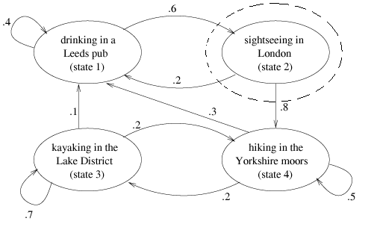
RWTE: Model Solution
For state 2:

Slide 42
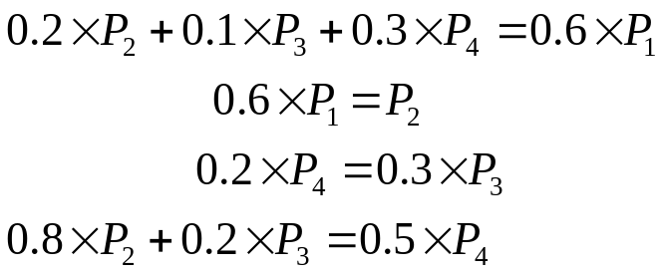

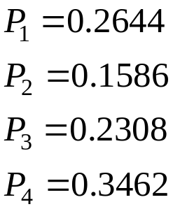
RWTE: Equilibrium Equations
For all states:
We also have:
Results

Slide 43
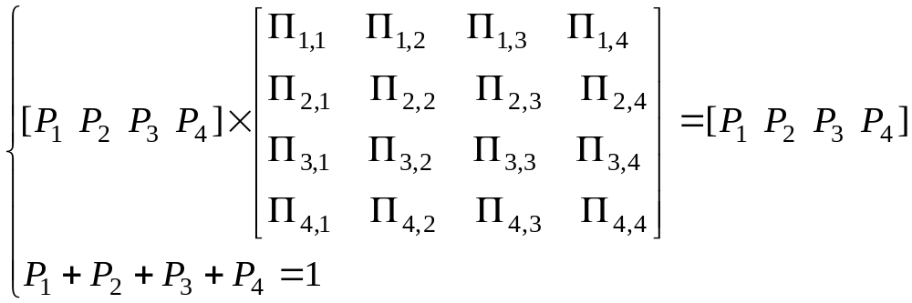
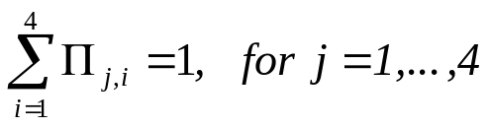
RWTE: Equations System
We could write the equations like follow:
П_{1,1}
1-П_{1,1}
1
П_{4,1}
П_{2,1}
П_{3,1}
4
2
3

Slide 44
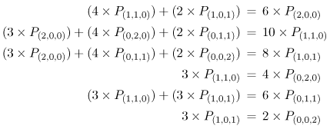
Database Server:
Model solution
For solving example 2 we can do as same as example 1:

Slide 45
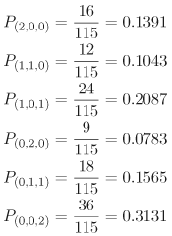
Database Server: Results
And steady state probabilities are:

Slide 46
RWTE: Question1
What percentage of days is the son actually not drinking in Leeds?
  Answer: 1- P₁ =74%.
  Since the steady state probability of being in state 1 (i.e., drinking in a Leeds pub) is 0.2644 (i.e., 26%), the rest of the time (74%) the lad is sightseeing, kayaking, or hiking.

Slide 47
RWTE: Question2
Once the son finishes a day of kayaking in the Lake District, how long will it typically be before he returns?
  Answer: 3.33 days
The mean time between entering a particular state (i.e., the state's "cycle time") is the inverse of the steady state probability of being in that state.
  Since the steady state probability of being in state 3 is 0.2308, the cycle time between successive entries into state 3 is 1/0.2308 = 4.33 days.
  Since it takes one day for the lad to kayak, the time from when he finishes a day of kayaking until he typically starts kayaking again is 4.33 – 1 = 3.33 days.

Slide 48
RWTE: Question3
How many days each month can the bobbies expect to see the son driving to London after drinking in Leeds?
  Answer: 4.76 days.
  Consider a 30 day month. The steady state probability of being found drinking in a Leeds pub (i.e., state 1) on any particular day is 0.2644. Thus, out of 30 days, 30 x 0.2644 = 7.93 days will find the lad drinking.
  However, since the lad decides to go to London with only probability 0.6 after a day of drinking in Leeds, the bobbies can expect to find the lad on the road to London 7.93 x 0.6 = 4.76 days each month.

Slide 49
RWTE: Question4
How many visits each month does the son typically visit the Lake District ?
  Answer: 2.08 visits per month.
  The only way to enter state 3 (i.e., kayaking) from another state is from state 4 (i.e., hiking).
  The steady state probability of being found hiking on any particular day is 0.3462, or 30 x 0.3462 = 10.39 days each month
  However, after hiking for a day, the lad only decides to go kayaking the next day with probability 0.2. Then, the lad typically starts a new visit to the Lake District 10.39 x 0.2 = 2.08 times each month.

Slide 50
RWTE: Question5
Typically how long does the son stays at the Lake District each visit?
  Answer: keeping the kayak an average of 3.33 days each visit.
  Since the steady state probability of being found kayaking is P₃=0.2308 on any particular day, the lad can be expected to be kayaking 30 x 0.2308 = 6.92 days out of each month.
  If he makes only 2.08 new visits each month, the duration of each visit is typically 6.92 / 2.08 = 3.33 days/visit.

Slide 51
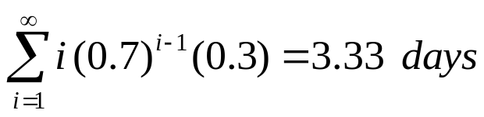
RWTE: Question 5’
An alternative solution for question 5.
  the lad kayaks for only one day with probability 0.3. He kayaks for exactly two days with probability 0.7 x 0.3. He kayaks for exactly three days with probability 2(0.7) x 0.3 and, in general, he kayaks for exactly n days with probability (0.7)^{n–1} x 0.3.
  The average time spent kayaking per visit is:

Slide 52
Database Server: User’s Question
What response time can the typical user expect?
  Answer: 44.24 seconds per user transaction.
  The response time can be found via application of the Interactive Response Time Law,
  R = M/X₀ – Z, eq 3.2.10 (chapter 3)
  Z (think time) =0 ,
  M (average number of users n the system ) =2
  We must find X₀ ( throughput )

Slide 53
Database Server: User’s Question’
  The throughput of the system, measured at the CPU, is the product of its utilization and its service rate.
  The CPU is utilized in states (2,0,0),(1,1,0), and (1,0,1). then the CPU utilization is P(2,0,0) + P(1,1,0) + P(1,0,1) = 0.1391 + 0.1043 + 0.2087 = 0.4521.
  The service rate of the CPU is 6 transactions per minute.
    Therefore, the throughput measured at the CPU is 0.4521 x 6 = 2.7126 transactions per minute,
  Resulting in an average response time of 2/2.7126 = 0.7373 minutes per transaction, which equals 0.7373 x 60 = 44.24 seconds per user transaction.

Slide 54
Database Server: System administrator's question
How near capacity (i.e., what is the utilization) of each of the system resources?
  Answer: The CPU's utilization is 0.4521, the fast disk's utilization is 0.3391, and the slow disk's utilization is 0.6783.
  These are found as direct sums of the relevant steady state probabilities.

Slide 55
Database Server: Company president's question
What new performance levels should be if we double the active users? The results are:
  Throughput: 3.4768 transactions per minute
  The user response time: 69.03 seconds per transaction
  The original system had a state space diagram of six states. The new system model has 15 states.

Slide 56
Database Server: Company pessimist's question
Since I know that the fast disk is about to fail and all the files will need to be moved to the slow disk, what will the new response time be?
  Answer: 65.00 seconds per transaction
  This number is a result of resolving the model with only two devices, the CPU and the slow disk.
  The resulting state diagram has only three states, with steady state probabilities: 0.0769, 0.2308, and 0.6923.
  This leads to a CPU utilization of 0.3077 and a system throughput of 1.8462 transactions per minute.
  R = M/X0 – Z= 2/1.8462-0=1.083 minute = 65 second

Slide 57
Model Assumptions: Memory-Less
Memory-less Assumption:
  It is assumed that all the important system information is captured in the state descriptors of a Markov model. That is, simply knowing which state the system is in, uniquely defines all relevant information.
  Knowing the current state alone is sufficient to determine the next sate. It doesn't matter how one arrives (i.e., by which path) to a particular state.
  It means, the only thing that is important in determining which state will be visited next is that the system is in a particular state at the current time

Slide 58
Model Assumptions:
Memory-Less’
This assumption also implies that the length of time that the system is in a particular state, by continually taking self loops, is irrelevant.
This places a nontrivial burden on choosing an appropriate notation for the state descriptor.
For instance, if the jobs have different characteristics, this must be evident from the state descriptor.
If the order in which jobs arrive to the systems makes a difference, this, too, must be captured in the state descriptor.
That is, previous history can be forgotten. This explains the term "memoryless" as it applies to Markov models

Slide 59
Limitations of Memory-Less Assumption
Resulting Limitation of memory-less assumption:
  Because everything must be captured in the state descriptor, Markov models are susceptible to state space explosion.
  For example, if there are 10 customers at the CPU, and the CPU is scheduled first-come-first-serve, then the number of state for the CPU will be 10! = 3,628,800
  However, if the customers behave similarly and the order of customer arrivals to CPU is not important, then the state descriptor of the CPU can be represented by a single number.

Slide 60
Limitations of Memory-Less Assumption’
Exponential Assumption:
  The exponential probability distribution is the only continuous distribution that is memory-less.
  E.g.: The average number of flips to get a head is two.
    knowing that the first flip resulted in a tail, the average number of flips still needed to get a head is again two.
  Another E.g.: suppose the average amount of CPU time required by a customer is 10 seconds.
    Knowing that the customer has already received 5 seconds worth of CPU time but not yet finished (i.e., previous history, which is irrelevant under the Markov memory-less assumption), the average amount of CPU time still needed is again 10 seconds.

Slide 61
Exponential
Thus, Markov models assume that:
the time spent between relevant events, such as job arrival times and job service times, is exponentially distributed.

Slide 62
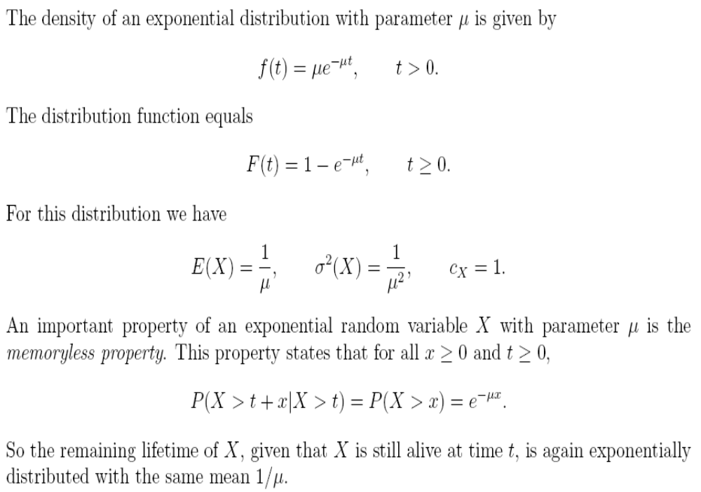
Exponential Distribution

Slide 63
Limitations of Memory-Less Assumption: Other Distributions
  E.g.: again suppose that the average amount of CPU time required by a customer is 10 seconds.
  By partitioning the total service requirement into two phases of service (i.e., each phase being exponentially distributed with an average of 5 seconds), the CPU state for each customer can be decoupled into two states.
    That is, each customer can be in either its first stage of service or in its second stage of service.
  This technique opens up a whole host of other distributions (i.e., not simply exponential) that can be closely approximated. However, the price is again a potential state space explosion since the state descriptors must now contain this additional phase information

Slide 64
Final Word
Theoretically, Markov models can be constructed to any desired level of accuracy.
The price is
  the complexity of the state descriptors and
  the resulting size of the state space.
Practically, beyond a few 1000 states, the computational complexity is limiting and any intuitive benefits are lost.
Thus, the system analyst is faced with a tradeoff of determining an acceptable level of aggregation that affords both accuracy and efficiency.

Slide 65
Generalized Birth-Death Models
Generalized Birth-Death model is a class of Markov models.
In each state, one of two events can occur:
  birth: the arrival of another customer
  death: the departure of a customer
In state k:
  birth: entering in state k+1 with rate λ_{k}
  death: entering in state k–1 with rate µ_{k}
λ₀
λ₁
λ₂
λ₃
λ_{k-1}
λ_{k}
0
1
2
3
k
μ₁
μ₂
μ₃
μ₄
μ_{k}
μ_{k+1}

Slide 66
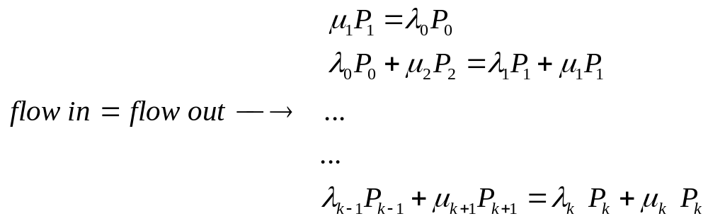
Flow balance Equations
λ₀
λ₁
λ₂
λ₃
λ_{k-1}
λ_{k}
0
1
2
3
k
μ₁
μ₂
μ₃
μ₄
μ_{k}
μ_{k+1}

Slide 67
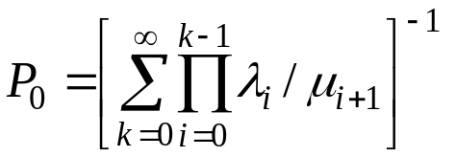
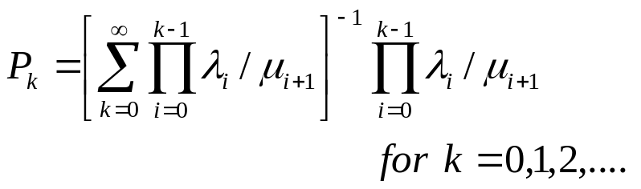
Generalized Equations
Equation 10.8.1
Equation 10.8.2

Slide 68

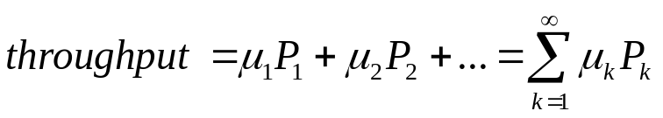
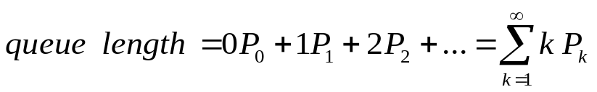
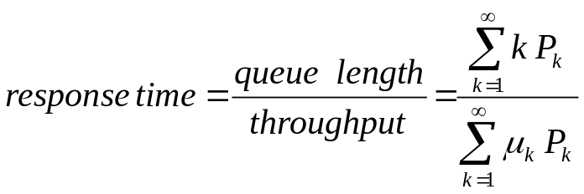
Performance Equations
Equation 10.8.3:
Equation 10.8.4
Equation 10.8.5
Equation 10.8.6
λ₀
λ₁
λ₂
λ₃
λ_{k-1}
λ_{k}
0
1
2
3
k
μ₁
μ₂
μ₃
μ₄
μ_{k}
μ_{k+1}

Slide 69
Definitions1
Definitions:
  Recurrent state: A state that can always be revisited in the future after leaving the state (A, B, C, F, G, H, and I)
  Transient state: A state that may not be possible to return to the state after leaving it, depending on the subsequent states visited. ( D and E )
A
D
E
F
I
B
C
G
H

Slide 70
Definitions1’
  Periodic state: A periodic state is a recurrent state where the system can only return to the periodic state in p, 2p, 3p, ..., steps, P>1 , p is the period
  States A, B, and C are periodic with a period of 3.
  The self loop around state H prohibits it (and also states F, G, and I) from being periodic
A
D
E
F
I
B
C
G
H

Slide 71
Facts of Definitions1
  Fact: Each state in the Markov model is either recurrent or transient.
  Fact: The set of recurrent states and the set of transient states is mutually exclusive and collectively exhaustive.
  Fact: All states reachable from a recurrent state are recurrent.
  Fact: All states that can reach a transient state are transient.
  Fact: All states reachable from a periodic state are periodic with the same period.

Slide 72
Definations2
Chain: A chain is a set of recurrent states that can all reach each other. The set is as large as possible. (A, B, and C ) form one chain. (F, G, H, and I) form another chain
Discrete state, discrete transition: A Markov model is discrete state, discrete transition if the number of states is countable and the transitions between states can only take place at known intervals.
Discrete state, continuous transition: A Markov model is discrete state, continuous transition if the number of states is countable and the transitions between states can take place at any time, driven by an exponential distribution.

Slide 73
Facts of Definitions2
Fact: Discrete state, continuous transition Markov models do not have periodic states. This is since transitions can take place at any time.
Major fact: Any finite Markov model, with no periodic states and whose recurrent states are all in the same chain, will have limiting state probabilities that are independent of the initial starting state. The example does not have steady state that is independent of the initial starting state because it has two chains, not one.
Fact: The steady state probability of being in a transient state is 0.

Slide 74
Model Construction Steps
Within the context of Markov models,
model construction consists of three steps:
state space enumeration
  specifying all reachable states that the system might enter
state transition identification
  identification indicates which states can be directly entered from any other given state
parameterization
  making measurements and making assumptions of the original system

Slide 75
Summary1
This chapter presents a basic, practical, and working knowledge of Markov models. Markov models fit within the general modeling paradigm which involves model construction, solution, calibration, alteration, and validation. Markov models are useful for both descriptive as well as predictive purposes. They are versatile and can model a wide range of applications. Two quite diverse applications are considered in this chapter and each of the modeling steps is demonstrated in detail. The assumptions and limitations of Markov models are summarized. The basics, as well as building blocks for more advanced topics, are presented.
In general, the primary limitation of Markov models is that they are susceptible to state space explosion. This explosion poses a danger that the computational complexity of solving the balance equations is prohibitive.

Slide 76
Summary2
Fortunately, there are subclasses of Markov models that lend themselves to efficient, alternative solution techniques. One such subclass of models is known as separable Markov models. (The database server example in this chapter is one example of a separable Markov model.) Separable Markov models can be solved using the Mean Value Analysis (MVA) technique, which is the topic of the following chapter.
We believe that the best way to learn about and to understand the subtleties of system modeling is not a passive process, but rather an active engagement. Arguably, the primary benefit of system modeling is the development of keen insights and intuition by the system analyst concerning the interdependencies between various modeling parameters. To this end, a rich set of exercises is provided. The reader is encouraged to participate by attempting to solve these exercises. They are not trivial.

Slide 77
Bibliography
[1] G. Bolch, S. Greiner, H. de Meer, and K. S. Trivedi, Queueing Networks and Markov Chains: Modeling and Performance Evaluation with Computer Science Applications, John Wiley & Sons, New York, 1998.
[2] P. J. Denning and J. P. Buzen, "The operational analysis of queueing network models", Computing Surveys, vol. 10, no. 3, September 1978, pp. 225–261.
[3] A. W. Drake, Fundamentals of Applied Probability Theory, McGraw-Hill Higher Education (Columbus), 1967.
[4] L. Kleinrock, Queueing Systems, Volume I: Theory, Wiley-Interscience, New York, 1975.
[5] E. D. Lazowska, J. Zahorjan, S. Graham, and K. C. Sevcik, Quantitative System Performance: Computer System Analysis Using Queueing Network Models, Prentice-Hall, Upper Saddle River, New Jersey, 1984.

Slide 78
Appendix:
Distributions

Slide 79
Gamma & Exponential Distributions
Exponential and gamma distributions find application in queuing theory and reliability studies.
The exponential distribution is a special case of the gamma distribution.
Examples:
  Time between customer arrivals at a terminal.
  Time to failure of electrical components.

Slide 80
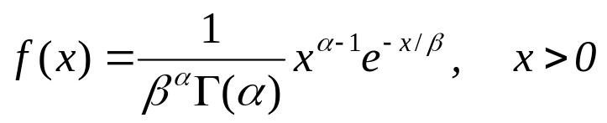
Gamma Distribution
where α > 0 and β > 0.
The mean and variance are:
μ = αβ and σ² = αβ²

Slide 81
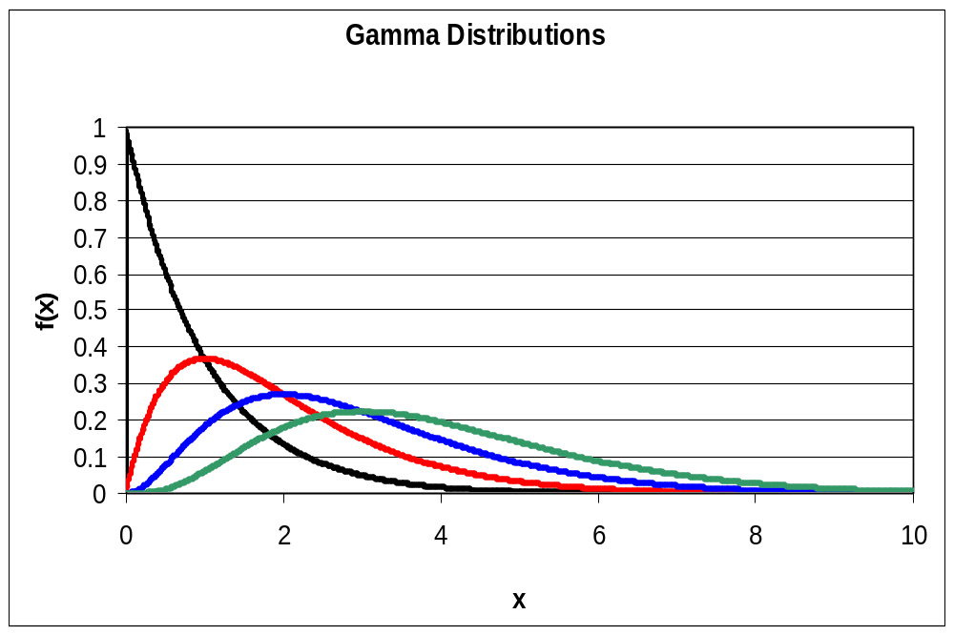
Gamma Distributions
α=1, β=1
α=2, β=1
α=3, β=1
α=4, β=1

Slide 82
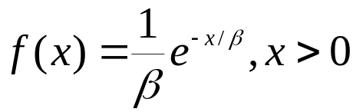

Exponential Distribution
A gamma distribution with α = 1 is called the exponential distribution.
where β > 0, μ = β and σ² = β²

Slide 83
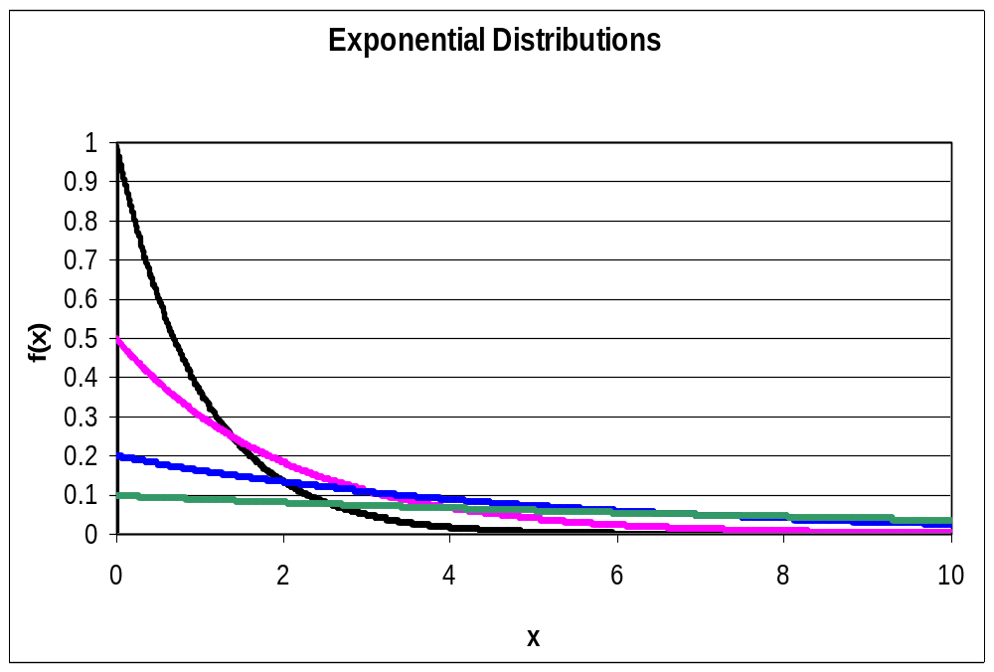
Exponential Distributions
α=1, β=1
α=1, β=2
α=1, β=5
α=1, β=10

Slide 84
Exponential Applications
EX: In a certain city, daily consumption of electric power (in millions of kilowatt hours) is a random variable that follows an exponential distribution with β = 3.
  What is the mean daily consumption of power?
  What is the variation of the daily consumption of power?
  If the city’s power plant has a daily capacity of 12 million kilowatt hours, what is the probability that this power supply will be inadequate on any given day?

Slide 85
Relationship between Exponential & Poisson
Recall that the Poisson distribution is used to compute the probability of a specific number of events occurring in a particular interval of time or space.
Instead of the number of events being the random variable, what if the time or space interval is the random variable?
EX: We want to model the space between defects in material. (Defect is a Poisson event)
EX: We want to model the time between radioactive particles passing through a counter. (arrival of radioactive particle is a Poisson event)

Slide 86
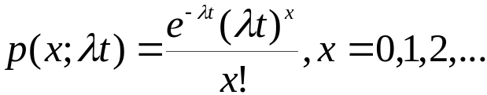
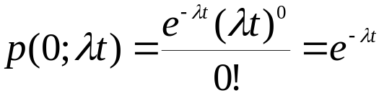
Relationship between Exponential & Poisson
Recall:
where λ is mean number of events per base unit time or space and t is the number of base units being inspected.
The probability that no events occur in the span of time (or space) t is:

Slide 87
Relationship between Exponential & Poisson
Let
  X = the time (or space) to the first Poisson event.
Note,
  the probability that the length of time (or space) until the first event > some time (or space),
  x is the same as the probability that no events will occur in x, which = e^{-λx}.
So, P(X > x) = e^{-λx} and P(X < x) = 1 - e^{-λx}
1 - e^{-λx} is the cumulative distribution function for an exponential random variable with λ = 1/β.

Slide 88

Relationship between Exponential & Poisson
Exponential distribution models time (or space) between Poisson events.
TIME
Note, β = 1/λ and λ = 1/β

Slide 89
Relationship between Exponential & Poisson
EX: Radioactive particles passing by a counter are Poisson events. Suppose the particles average 2 per millisecond.
(a) What is the probability that at least 1 particle will pass in 3 milliseconds?
(b) What is the probability that more than 1 millisecond will elapse before the next particle passes?

Slide 90
Gamma Application
Exponential models time (or space) between Poisson events.
Gamma models time (or space) occurring until a specified number of Poisson events occur with α = the specific number of events and β = mean time (or space) between Poisson events.
EX: Radioactive particles passing by a counter follow a Poisson process with an average of 4 particles per millisecond. What is the probability that up to 2 millisecond will elapse until 3 particles have passed the counter?
g( x<2;α=3, β=0.25 ) = 0.9862

Slide 91
Exponential & Binomial Application
EX: Let
  X = the time in 1,000’s of hours to failure for an electronic component. X follows an exponential distribution with mean time to failure β = 10 (remember that is 10,000 hours).
(a) What is the probability that the electronic component is functioning after 15,000 hours?
(b) If 6 of these electronic components are installed in different systems, what is the probability that at least 3 are still functioning at the end of 15,000 hours?

Slide 92
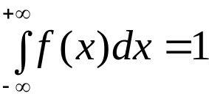
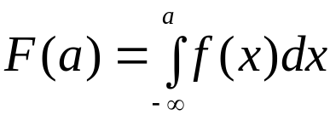

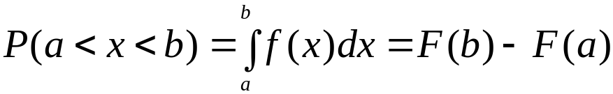
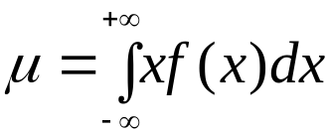
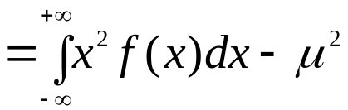

Continuous Distribution Summary
True for all continuous distribution:

Slide 93
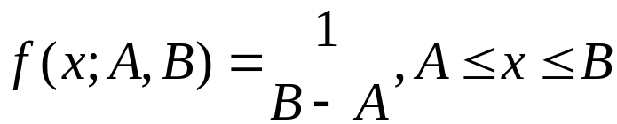
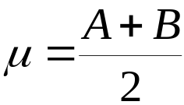
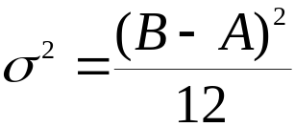
Continuous Distribution Summary
Continuous Uniform

Slide 94
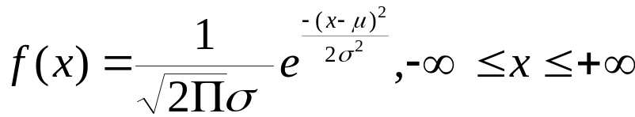


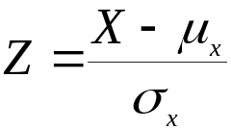
Continuous Distribution Summary
Normal distribution
,where Z is standard normal

Slide 95
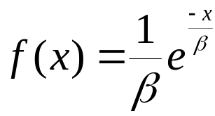
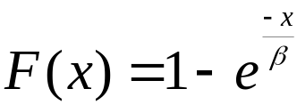
Continuous Distribution Summary
Exponential distribution
,where β > 0
μ = β
σ² = β²
Exponential distribution models time (or space) between Poisson events. Note, β = 1/λ and λ = 1/β

Slide 96
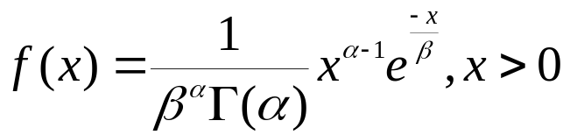
Continuous Distribution Summary
Gamma distribution
where α > 0 and β > 0
μ = αβ
σ² = αβ²
Gamma distribution models time (or space) occurring until a specified number of Poisson events occur with α = the specific number of events and β = mean time (or space)between Poisson events.

